Slide 1
Hello! Welcome to…
ESL Class!

Slide 2
Today we will learn:
Let’s Talk!
Common Phrases in Conversation
Notes:
Make sure to pass out name tags either BEFORE class or AT THIS TIME!

Slide 3
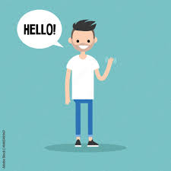
*Recap of previous lesson*
Greetings
Hello
Hi
Good morning/afternoon/evening
How are you?

Slide 4
*Recap of previous lesson*
Introductions
My name is… (say your name)
Nice to meet you!
What’s your name?

Slide 5
Click this link and watch this video to see how two people would introduce themselves to each other!
https://youtu.be/RvubptBex7w

Slide 6
Responding to “How are you?”
I’m fine, thank you. (common)
I’m good. (informal)
I’m doing well. (formal)

Slide 7
Asking Questions
How are you?
Do you speak English?
Where are you from?

Slide 8
Responses for: How are you? // How are you doing?
I am doing fine.
I am doing well.
I am doing great!
Notes:
After explaining the examples, have the students try.

Slide 9
Do you speak English? (Tu hablas ingles?)
I speak a little bit of English.
No, I do not speak English.
Yes! I do speak English.

Slide 10
Where are you from?
I am from Oklahoma.
I am from Mexico.
I am from South Korea.
Notes:
After introducing these phrases, ask the students if there’s anything they would like to know how to ask for.

Slide 11
New phrases!
What do you do?
I am a waitress/teacher/librarian…
What are your hobbies?
I like to play guitar, go on walks, spend time with my family…

Slide 12
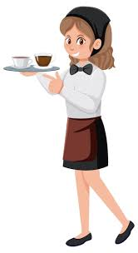
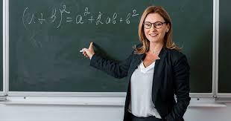
What do you do?
I am a waitress.
I am a teacher.
I am a librarian.

Slide 13
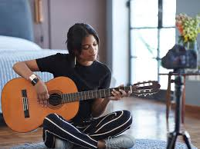
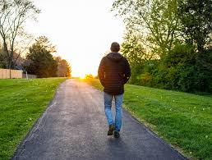
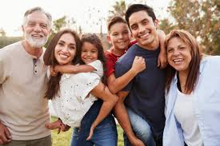
What are your hobbies?
I like to play guitar.
I like to go on walks.
I like to spend time with my family.

Slide 14
Until Next Time!
Rewatch the YouTube video
Practice your greetings
Practice introducing yourself!

